Slide 1
It Followed Me Home:
Exploring Strong Last Hop Devices and CDNs

Slide 2
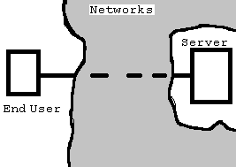
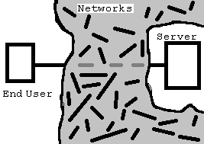
Say I have a server...
Client requests data, server sends it
Latency (distance to server)
Path (potentially many nodes crossed)
Potential server bottleneck

Slide 3
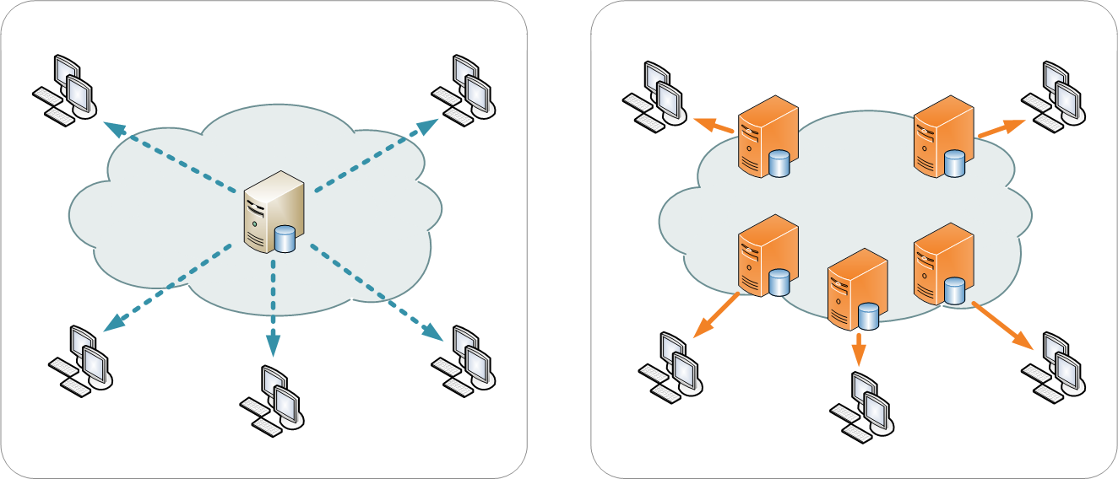
Now I have many servers...
Points of Presence (PoPs) spread over an area
Distributed services
Potentially shorter distances to average end user
Could have strong backbone to facilitate internetwork transit
Still must cross networks to reach user, may have worst case distances, server bottleneck
Problem has been reduced, not eliminated
Cost of extension adds up
Server synchronization
Infrastructure laying
Support staff
Deal making
https://en.wikipedia.org/wiki/Content_delivery_network#/media/File:NCDN_-_CDN.png

Slide 4
Now What?
Once data is delivered to user keep it there for future requests (caching)
Shortest distance, fastest response time, no need to cross networks again
Less affected by “Middle Mile” congestion
An extension: What if two users request the same data?
Assume sequential request, similar geographic area
Can have the first user deliver the data to the second user (Peering)
Doubles value of client side application (doubles as player and server)
Both involve the usage of end user devices
End user devices have many drawbacks
Capability
Reliability
Consent
Security (Somewhat alleviated by a hybrid approach)

Slide 5
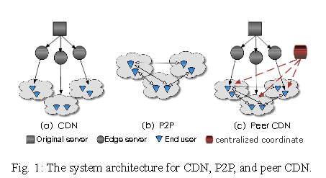
CDN (Summary)
CDNs, serve content, edges facilitate caching and forwarding within CDN network
Standard, Peer only, Peer-assisted, CDN-assisted
Standard: Netflix, Akamai, Google, Youtube
Peer only: Joost, Kankan
Peer CDN: ChinaCache, Youku
Each has customized approach to delivery
Netflix’s inserted hardware (Openconnect)
Akamai regionalization
Some own backbones
Joost and Kakan utilize peering
1 to N nodes, spanning large ranges
Ming Ma, Zhi Wang, Ke Su, Lifeng Sun. 2018. Understanding the Smartrouter-based Peer CDN for Video Streaming.arXiv:1605.07704. Retrieved from https://arxiv.org/abs/1605.07704

Slide 6
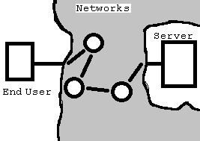
Crossing the Gap
Edge of CDN to end user (Bottleneck/problematic space)
Path to end user is of varying quality and length
Ownership of paths can complicate traversal (BGP, routing policy, traffic)
Devices along path have varying quality
Microcosm of broader network issues
Overall problem is unpredictability (or at least difficulty to ascertain variance in real time)
Solutions are forms of adding predictability/known capabilities to “wild space”
Extension: A PoP at the end user level

Slide 7
Strong Last Hop Devices
Solve Peering problem with standardization and powerful devices at the end user
Essentially a dedicated peer
SDNs, CDNs, Cloud Computing (Edge Computing) all pushing for stronger edge devices in some form or another
SDN/NFV: Flexibility of nodes, reconfigurability
CDN: Streaming capability, caching, scalability, flexibility
Edge: Application streaming, IOT management
Steam, PUBG, Fortnight
ISPs using devices to extend service range for other users
Comcast Routers as public/private wi-fi hotspots
Smart Routers, MEC devices, Desktop streaming

Slide 8
Issues with Last Hop Devices
Issues of gap still present, further minimized
Wi-Fi/Mobile bottleneck
Number of users
Service area size
User mobility
Business model problems (lopsided incentive)
Users provide largest expense
CDN synchronization problems
Potential worst case for synchronization
Cost of device
Hardware, but also software layers added to achieve flexibility
Securing nodes

Slide 9
Potential Research Angles
Wi-Fi bottleneck: Multiplex over bluetooth and mobile
Business model: Service Sharing
Mentioned by “Consume Local” paper, explores bit based compensation
Cost/Benefit of devices vs straight access
Modular Device for scalable ends
Streaming Application QOE
SDN Coordination (“disconnected” node coordination)
Demographic based caching, routing priority
Creator based injection (Mentioned by SmartRouter paper)
Reexamining the upload download ratio

Slide 10
Opportunities Stronger Devices provide
IOT:
Out of band management
Organization of Devices to minimize bloat traffic
Securing of IOT devices
Security/Accountability:
Addressing of Users
Securing User data Locally

Slide 11
Questions

